Slide 1
ALSET
Landsat Reflectance Data: On the Fly and at Your Fingertips
By:
Bálint Molnár
Kristóf Molnár

Slide 2

BASIC IDEA
Landsat Data Comparison
Satellite Pass Notifications
Ground Reference Data
Interdisciplinary Learning
Open Access Satellite Data

Slide 3
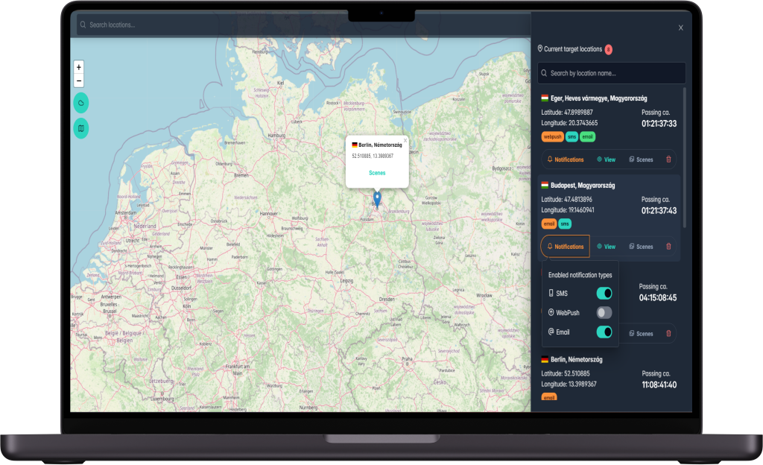
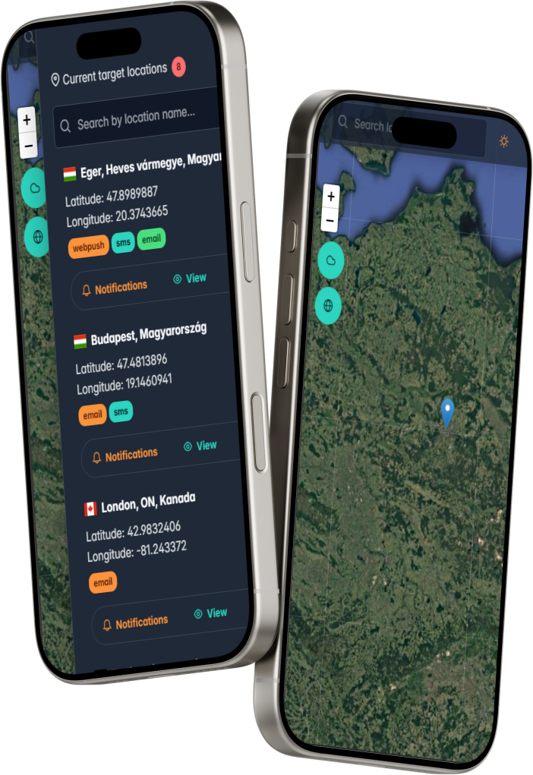
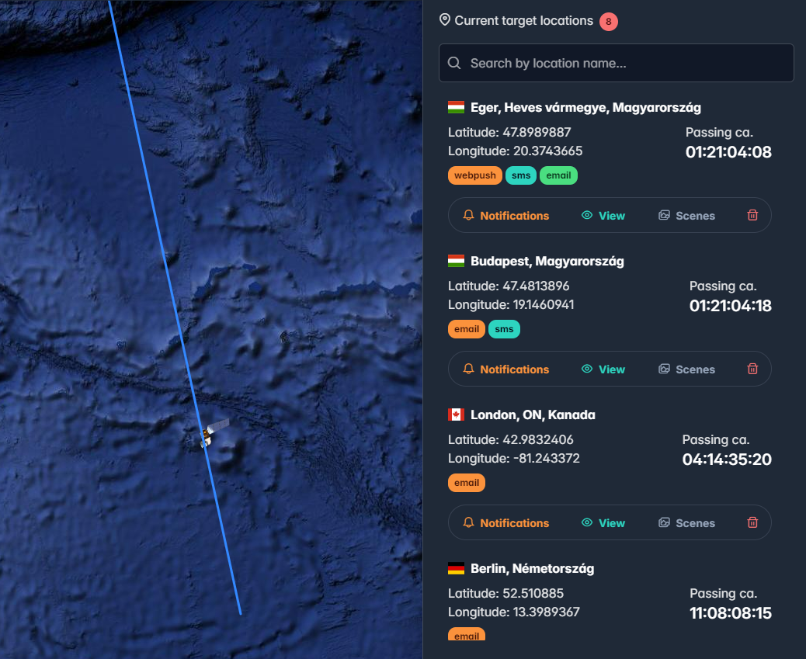
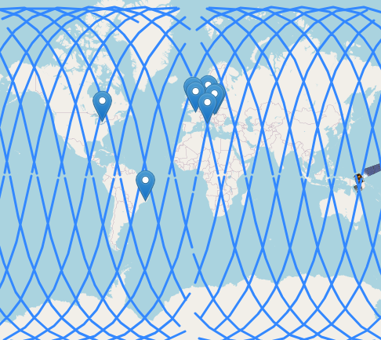
SOLOTION OVERVIEW
MODERN UI/UX
ACCESSIBILITY
FEATURE RICH AND PRCEISE

Slide 4
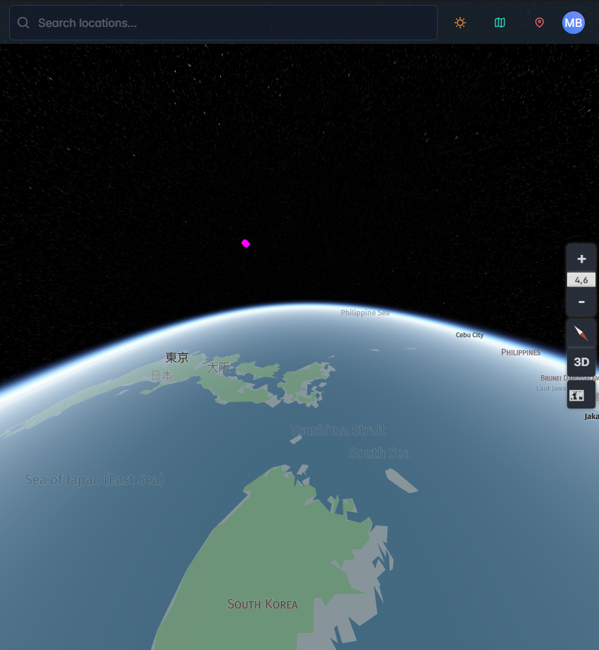
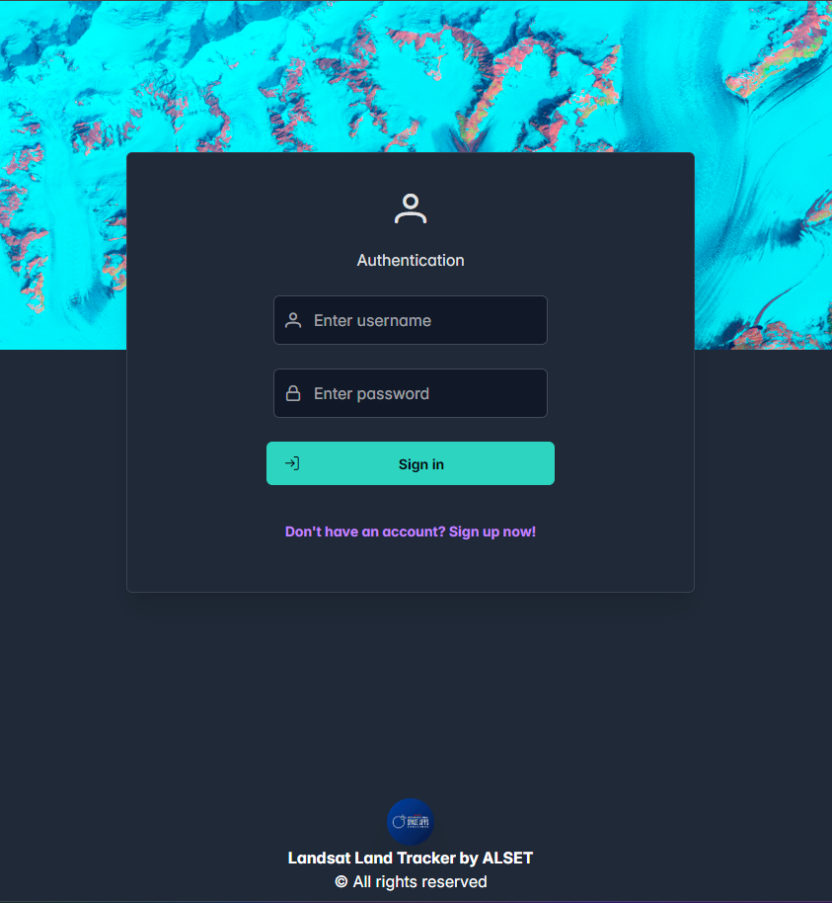
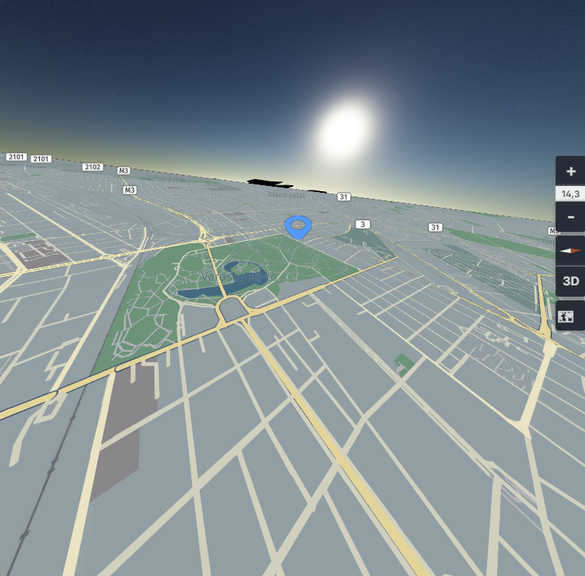
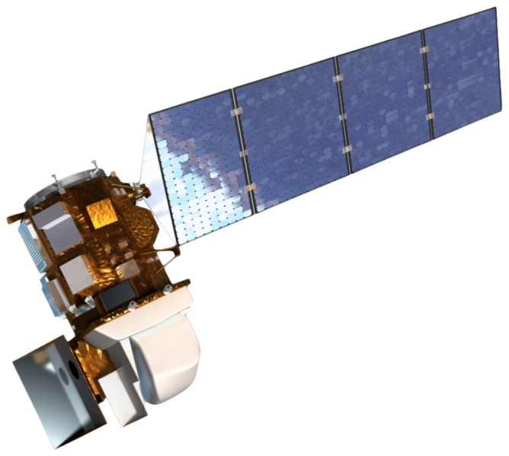
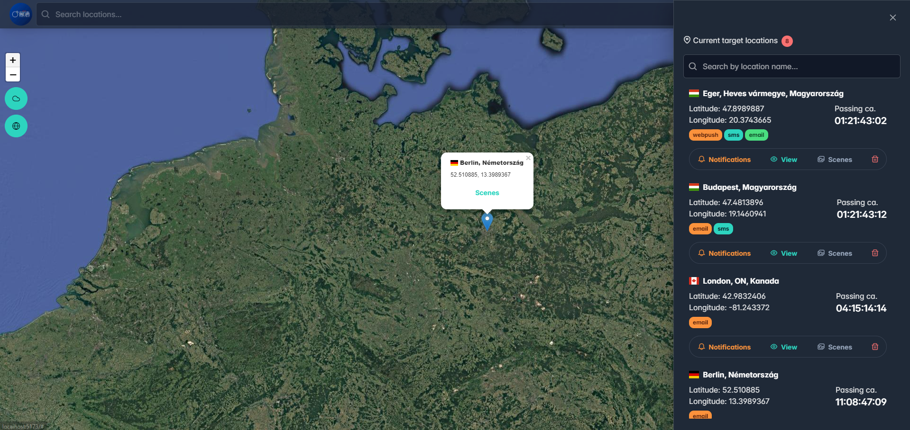
SOLOTION OVERVIEW

Slide 5
OUR VISIONS
SaaS for precision agriculture
Predict and optimaze land state with AI
Integrate precision cultivation vechicles

Slide 6
TECHNICAL DETAILS
Optimal way to determine overpassing time
Using USGS and 3rd party APIs to access data
Using modern technologies for fast and reliable use
Calculate satellite location with precision of seconds.
Multiple notifcation system
Collecting telemetry data for ML
Analyzing scene SR data (histogram for bands)

Slide 7

THANK YOU FOR YOUR KING ATTENTION
To the infinity and beyond…

